Slide 1


Supermarket billing system using C++
[processed by: Gaurangi Tyagi|
|B.Tech(CS); section D; III sem|
|Roll no. 2018341]

Slide 2

INTRODUCTION
This project deals with Supermarket Automation.
A supermarket is a self-service store offering a wide variety of items related to food, household or daily use.
Includes both sale and purchase of products.
This project is designed to make the existing system more informative, reliable, fast and easy for all the stake-holders.

Slide 3
OBJECTIVE
To produce a software that manages the activities done in a supermarket.
To maintain stock details.
To reduce time taken in calculations of sales activities.
To reduce paperwork so that the user spends more time in managing the supermarket.
To store large amount of data and avoid clumsiness.

Slide 4
PROJECT DESCRIPTION
First activity is adding the items to the system along with their names, price and product codes.
Modifications can be done easily but only by admin.
Rights to delete an item are also with the admin
The billing team can enter the codes of the products that customer has purchased and quantity to generate a bill.

Slide 5
TECHNOLOGY USED
Programming language
Operating System
Platform

Slide 6
FEATURES OF C++ USED
OOPS CONCEPTS
Encapsulation
Abstraction
Class
Objects
FILE HANDELING OPERATIONS
Reading from file
Writing in a file
Header files
<fstream>
<iostream>

Slide 7
FUNCTIONS
void menu() To display main menu of the program, where user has to choose if he wants to use the program as administrator or as buyer
void admin() To display admin menu where he/she can choose to add/modify/delete the products in supermarket database.
void buyer() To display buyer menu that allows the user to select the products that he/she wants to buy from the available products
void add() allows admin to add products.
void edit() allows admin to modify the existing products.
void rem() allows admin to remove products.
void list() To display the available items with their code to the buyer.
void receipt() All the calculations are performed in this function. It also displays the final bill.

Slide 8
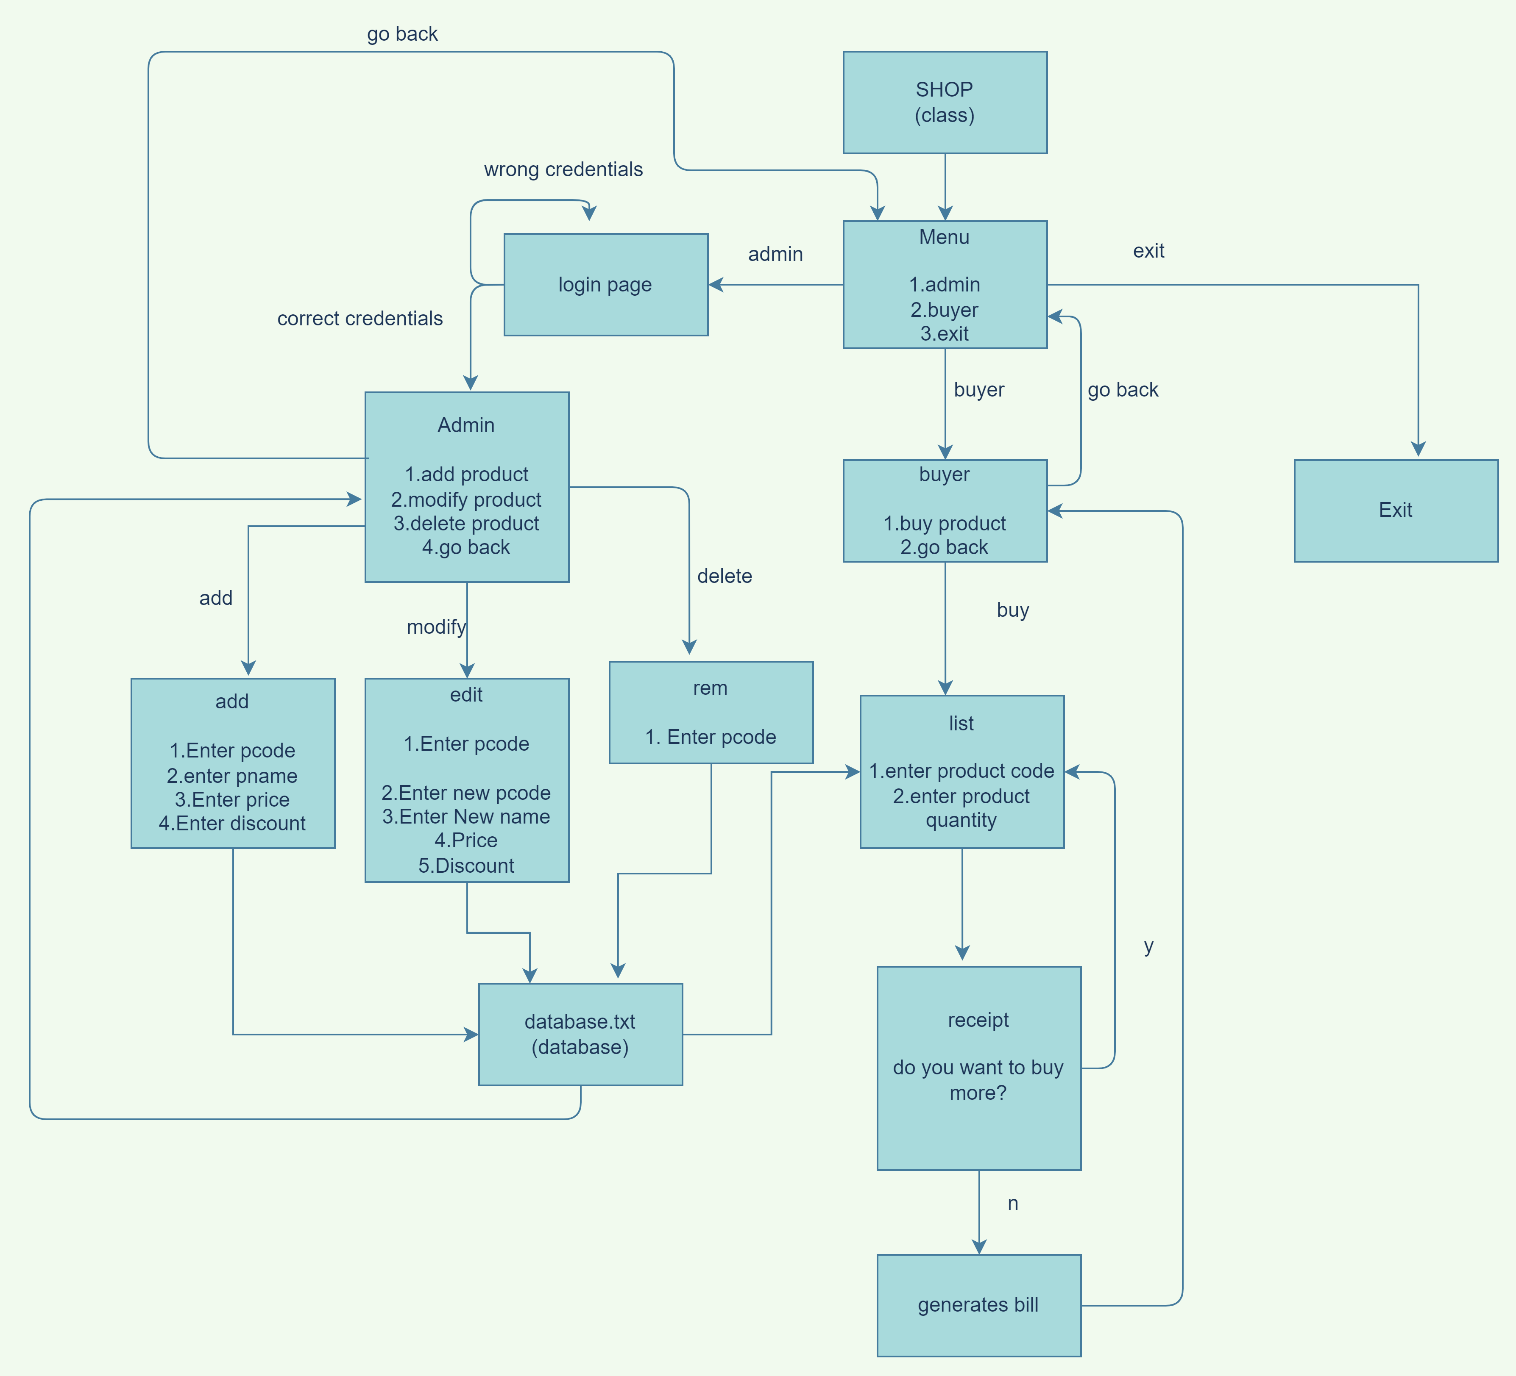

Slide 9
CONCLUSION
This system is designed in C++ to reduce the time taken by the sales activities.
The system has been developed with OOPS concepts.
The system is strong to handle daily operations.
The database needs to be cleared over certain time to save storage.
It can be further improved.

Slide 10
THANK YOU!

